Slide 1
CPSC 4430/5440: Machine Learning LessonD06(b): LSTM
Based on notes from Xavier Giró-i-Niet

Slide 2
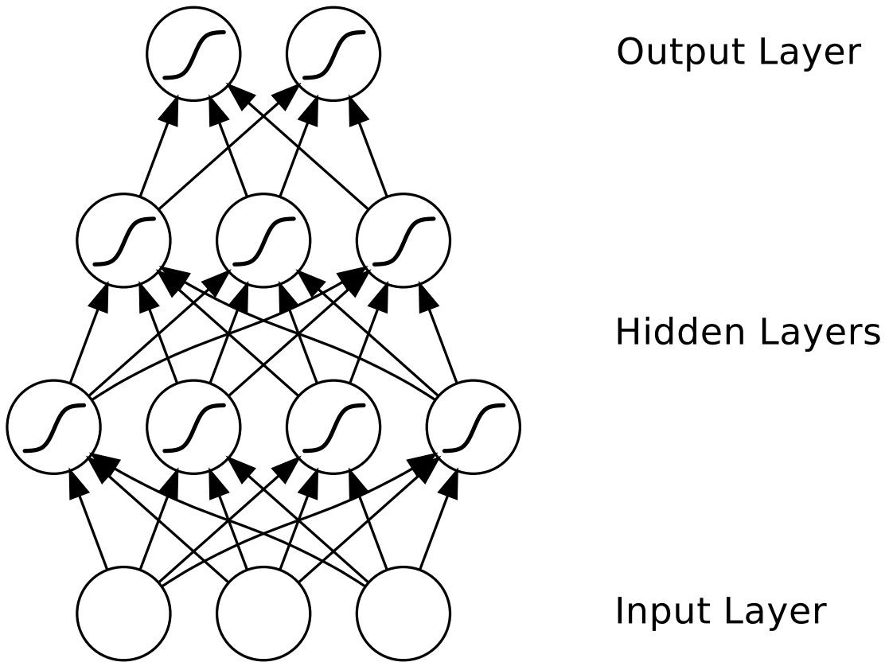
Multilayer Perceptron
The output depends ONLY on the current input.
Alex Graves, “Supervised Sequence Labelling with Recurrent Neural Networks”
2

Slide 3
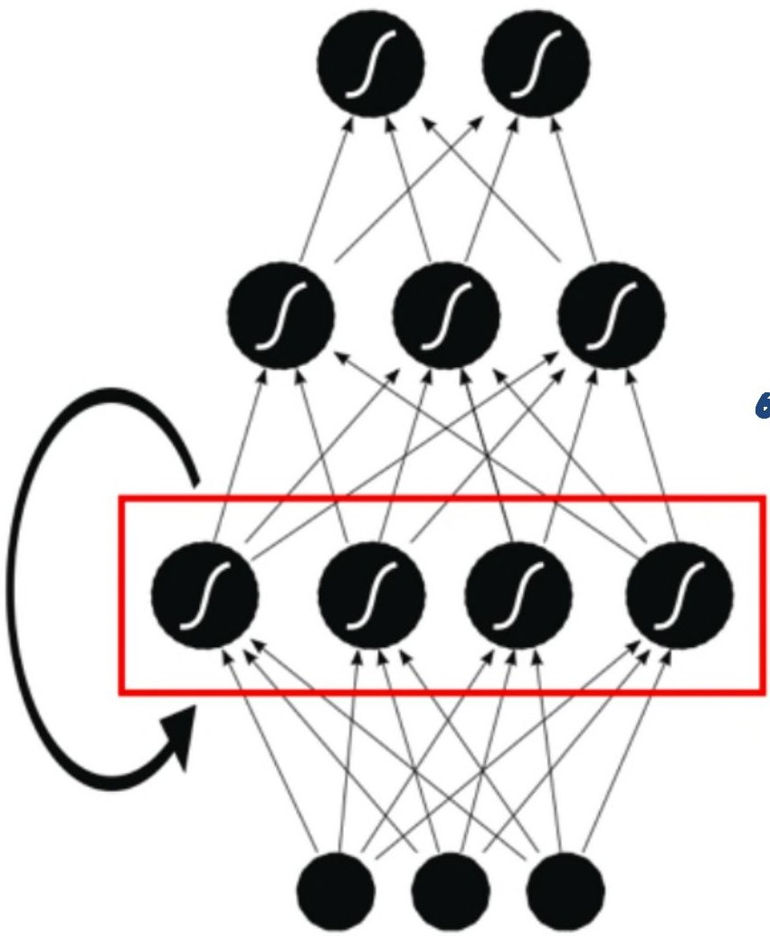
Recurrent Neural Network (RNN)
The hidden layers and the output depend from previous states of the hidden layers
Alex Graves, “Supervised Sequence Labelling with Recurrent Neural Networks”
3

Slide 4
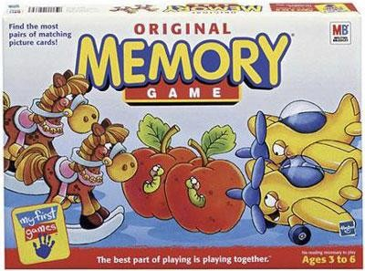
Recurrent Neural Network (RNN)
The hidden layers and the output depend from previous states of the hidden layers
Alex Graves, “Supervised Sequence Labelling with Recurrent Neural Networks”
4

Slide 5
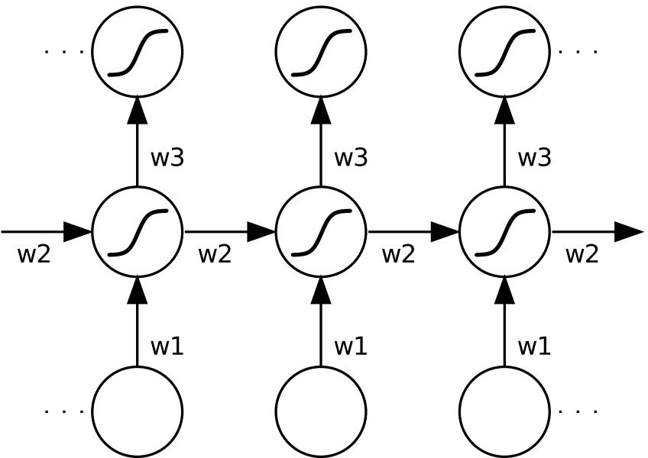

Recurrent Neural Network (RNN)
Front View
Side View
Rotation 90º
Rotation 90º
time
time
8

Slide 6
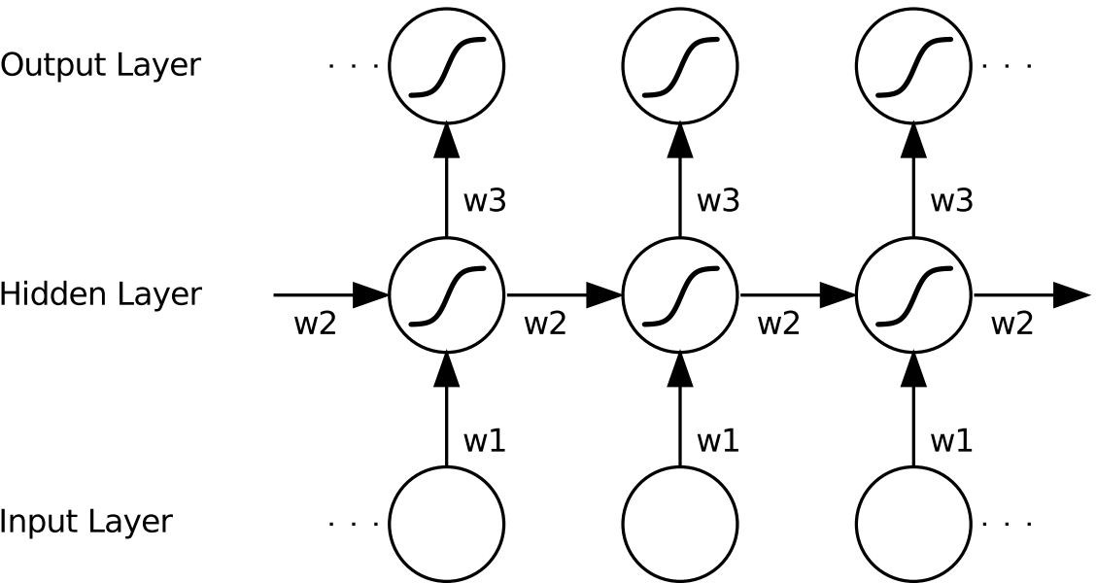


Recurrent Neural Networks (RNN)
Each node represents a layer of neurons at a single timestep.
t-1
t
t+1
Alex Graves, “Supervised Sequence Labelling with Recurrent Neural Networks”

Slide 7

Recurrent Neural Networks (RNN)
The input is a SEQUENCE x(t)
of any length.
t-1
t
t+1
Alex Graves, “Supervised Sequence Labelling with Recurrent Neural Networks”

Slide 8

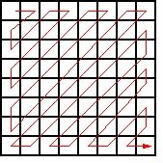
Recurrent Neural Networks (RNN)
Common visual sequences:
The input is a SEQUENCE x(t)
of any length.
Still image
Spatial scan
(zigzag, snake)

Slide 9



Recurrent Neural Networks (RNN)
Common visual sequences:
...
The input is a SEQUENCE x(t)
of any length.
t
Video
Temporal
sampling

Slide 10
Recurrent Neural Networks (RNN)
Must learn temporally shared weights w2; in addition to w1 & w3.
t-1
t
t+1
Alex Graves, “Supervised Sequence Labelling with Recurrent Neural Networks”

Slide 11
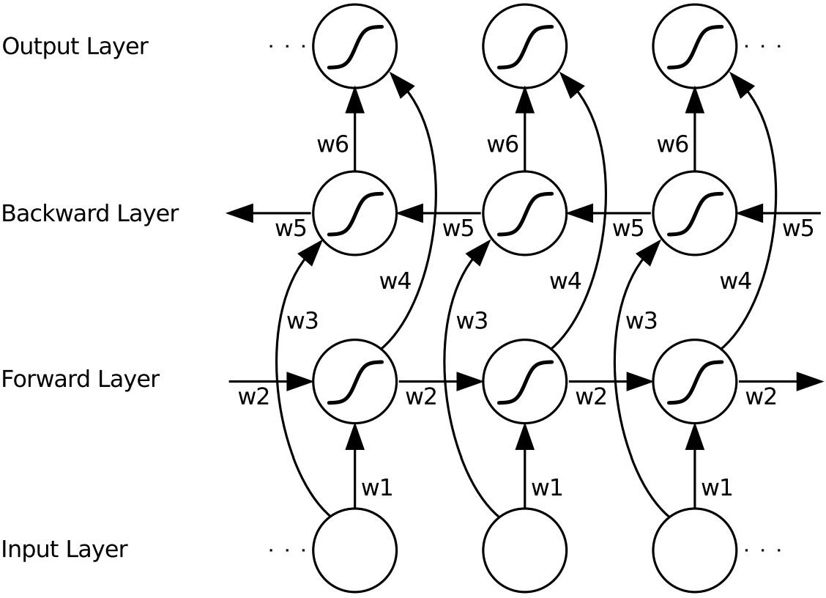
Bidirectional RNN (BRNN)
Must learn weights w2, w3, w4 & w5; in addition to w1 & w6.
Alex Graves, “Supervised Sequence Labelling with Recurrent Neural Networks”

Slide 12
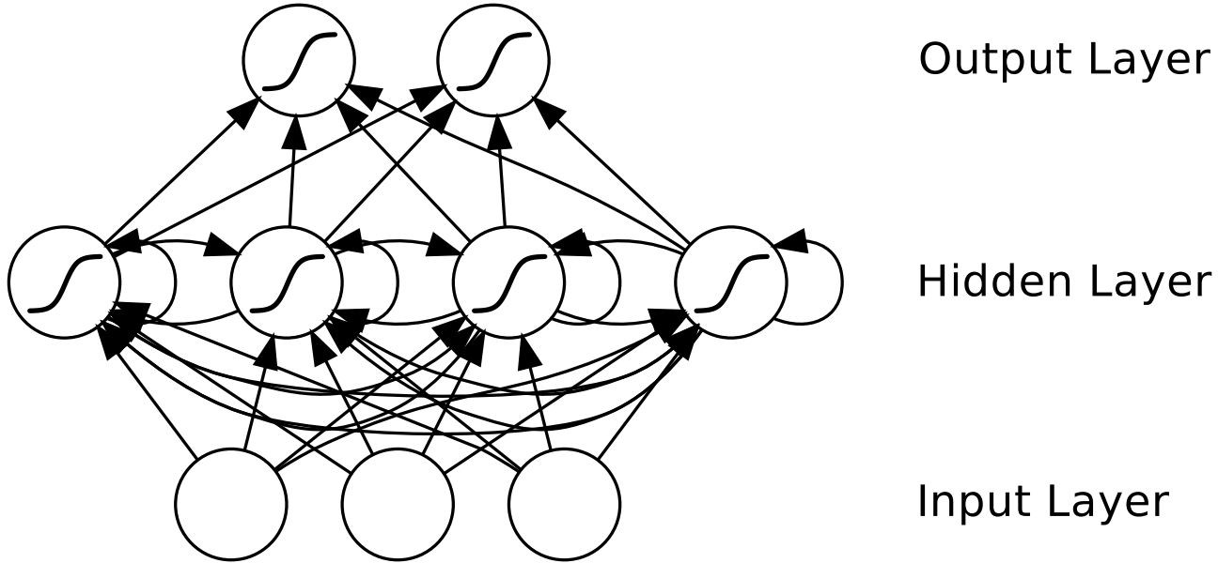
Bidirectional RNN (BRNN)
Alex Graves, “Supervised Sequence Labelling with Recurrent Neural Networks”

Slide 13
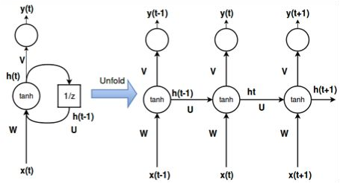
Formulation: One hidden layer
Delay unit (z⁻¹)
Slide: Santi Pascual
16

Slide 14
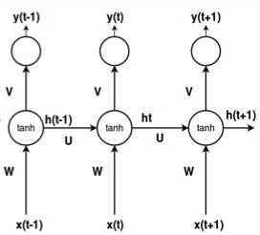
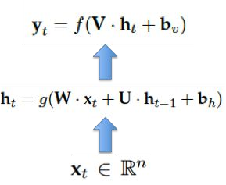


Formulation: Single recurrence
One-time Recurrence
Slide: Santi Pascual
17

Slide 15
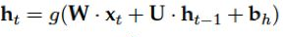

Formulation: Multiple recurrences
One time-step recurrence
T time steps recurrences
Recurrence
Slide: Santi Pascual

Slide 16
RNN problems
Long term memory vanishes because of the T nested multiplications by U.
...
Slide: Santi Pascual

Slide 17
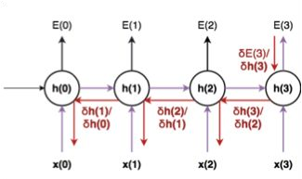
RNN problems
During training, gradients may explode or vanish because of temporal depth.
Example: Back- propagation in time with 3 steps.
Slide: Santi Pascual

Slide 18
Vanishing or Exploiding Gradient
https://www.youtube.com/watch?v=qss30DuhbCo

Slide 19
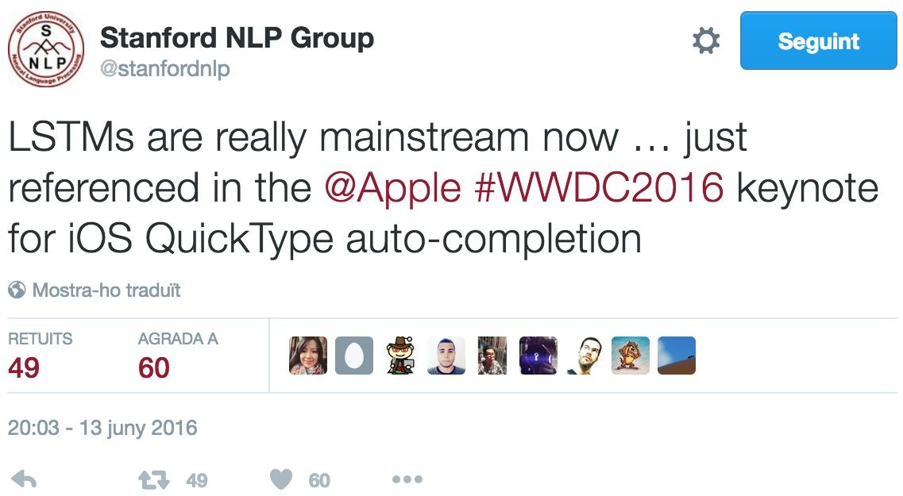
Long Short-Term Memory (LSTM)
21

Slide 20
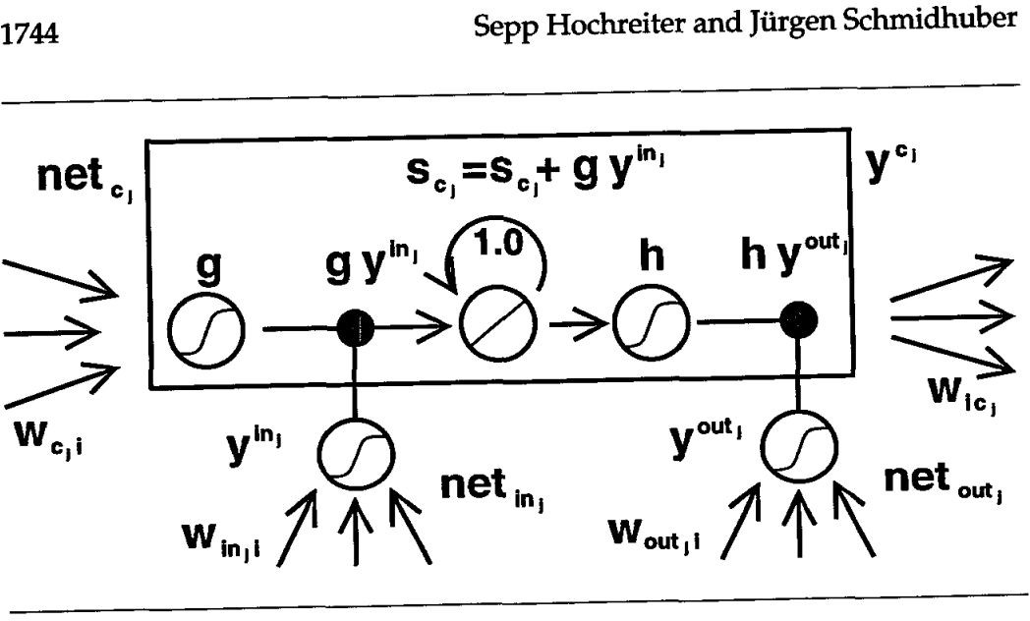

Long Short-Term Memory (LSTM)
Hochreiter, Sepp, and Jürgen Schmidhuber. "Long short-term memory." Neural computation 9, no. 8 (1997): 1735-1780.
22

Slide 21
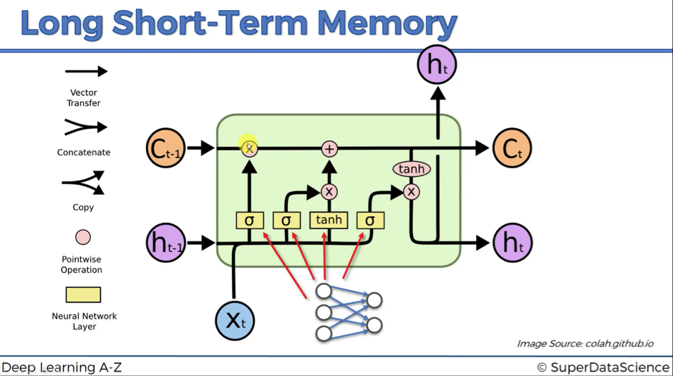
https://www.youtube.com/watch?v=8HyCNIVRbSU

Slide 22
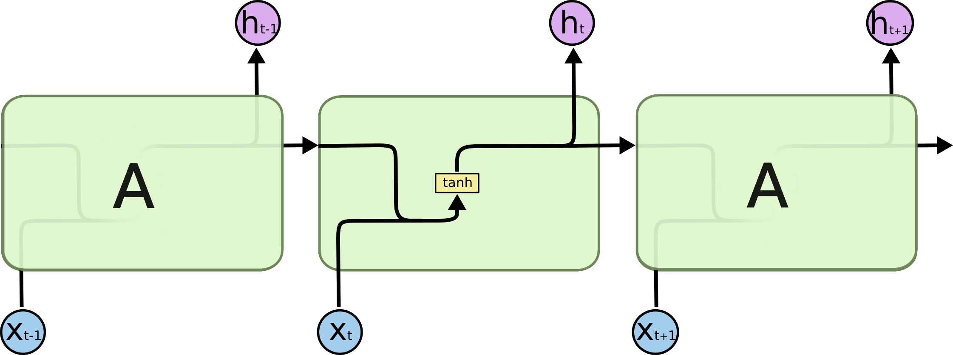
Long Short-Term Memory (LSTM)
Based on a standard RNN whose neuron activates with tanh...
Figure: Cristopher Olah, “Understanding LSTM Networks” (2015)

Slide 23
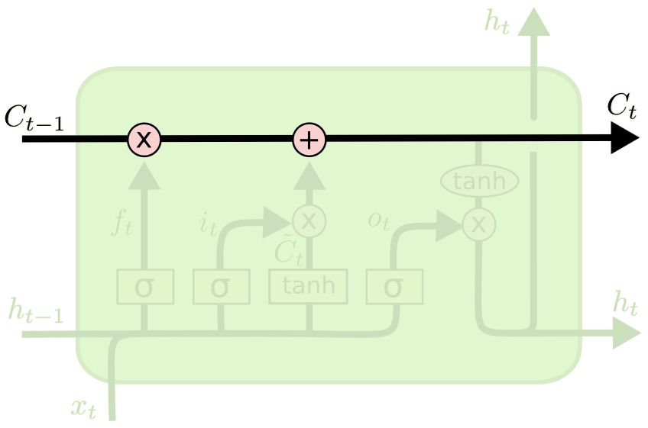
Long Short-Term Memory (LSTM)
C_{t} is the cell state, which flows through the entire chain...
Figure: Cristopher Olah, “Understanding LSTM Networks” (2015)

Slide 24
Long Short-Term Memory (LSTM)
...and is updated with a sum instead of a product. This avoid memory vanishing and exploding/vanishing backprop gradients.
Figure: Cristopher Olah, “Understanding LSTM Networks” (2015)

Slide 25
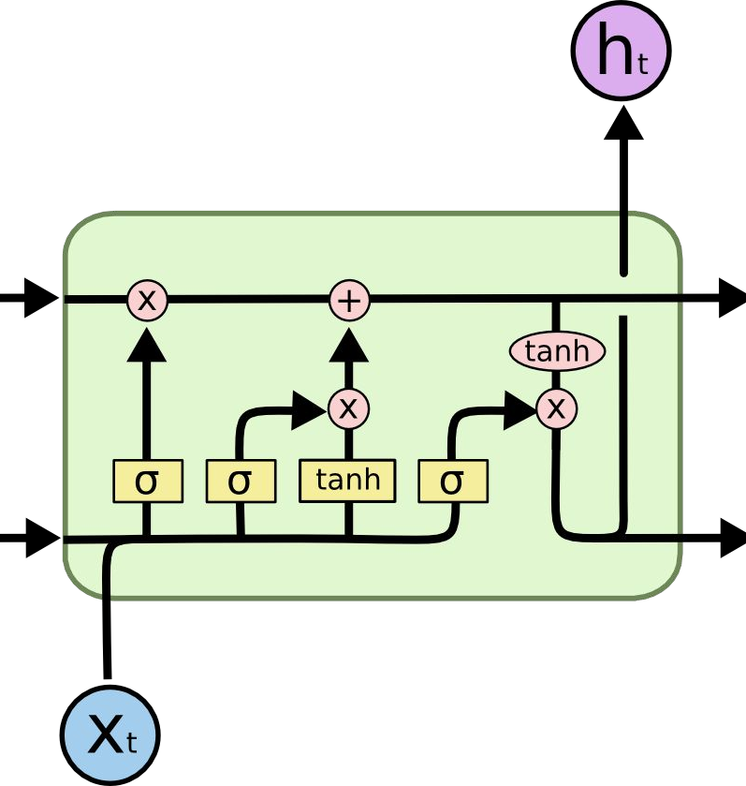
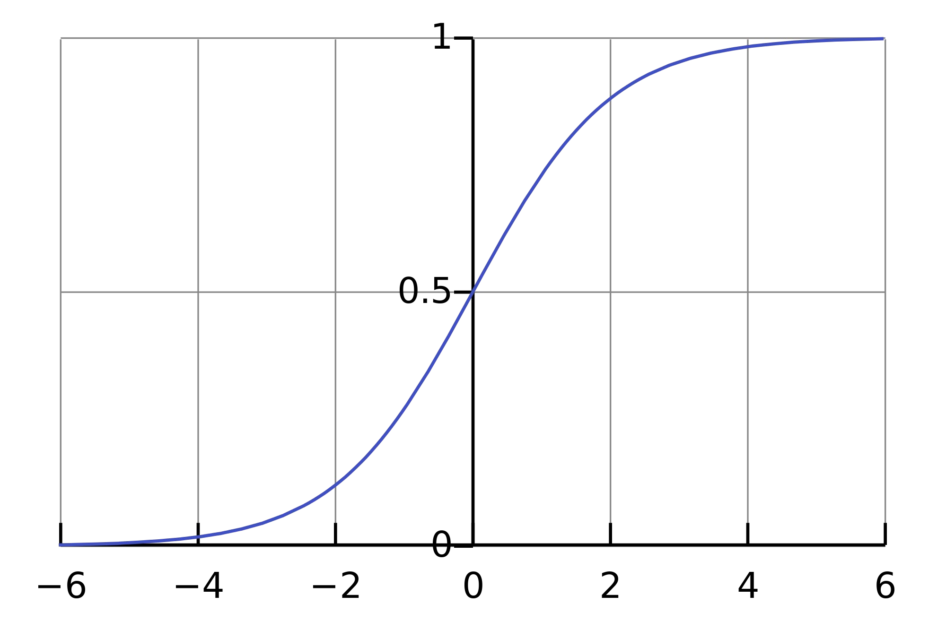
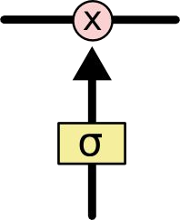
Long Short-Term Memory (LSTM)
Three gates are governed by sigmoid units (btw [0,1]) define the control of in & out information..
Figure: Cristopher Olah, “Understanding LSTM Networks” (2015)

Slide 26
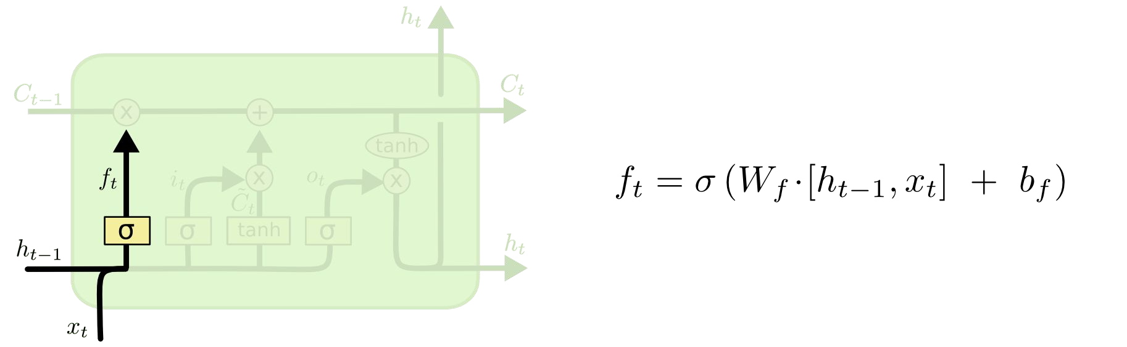

Long Short-Term Memory (LSTM)
Forget Gate:
Concatenate
Figure: Cristopher Olah, “Understanding LSTM Networks” (2015) / Slide: Alberto Montes

Slide 27
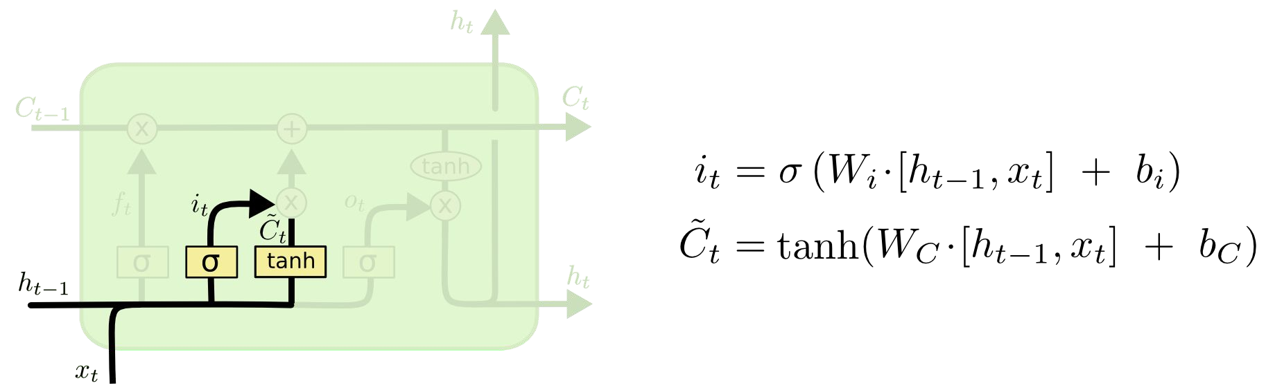
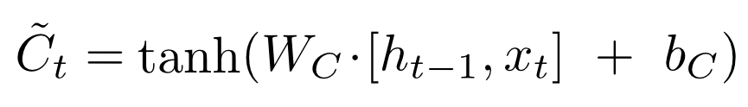
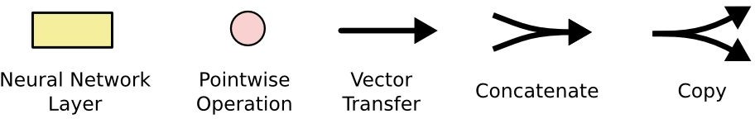
Long Short-Term Memory (LSTM)
Input Gate Layer
New contribution to cell state
Classic neuron
Figure: Cristopher Olah, “Understanding LSTM Networks” (2015) / Slide: Alberto Montes

Slide 28
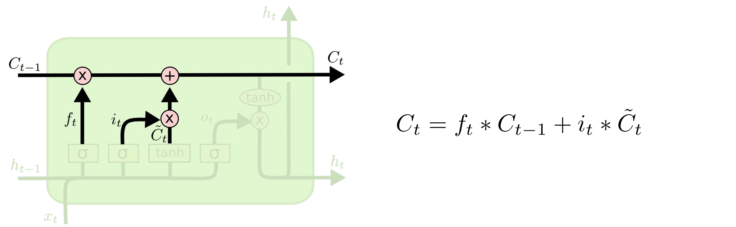
Long Short-Term Memory (LSTM)
Update Cell State (memory):
Figure: Cristopher Olah, “Understanding LSTM Networks” (2015) / Slide: Alberto Montes

Slide 29
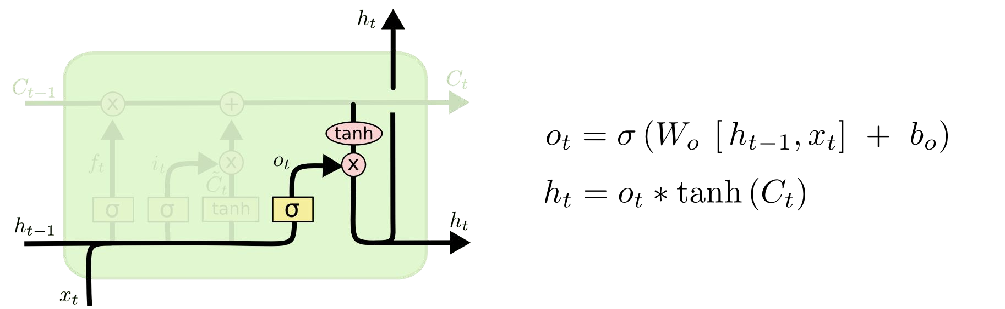
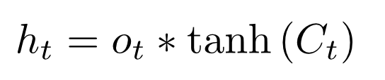
Long Short-Term Memory (LSTM)
Output Gate Layer
Output to next layer
Figure: Cristopher Olah, “Understanding LSTM Networks” (2015) / Slide: Alberto Montes

Slide 30
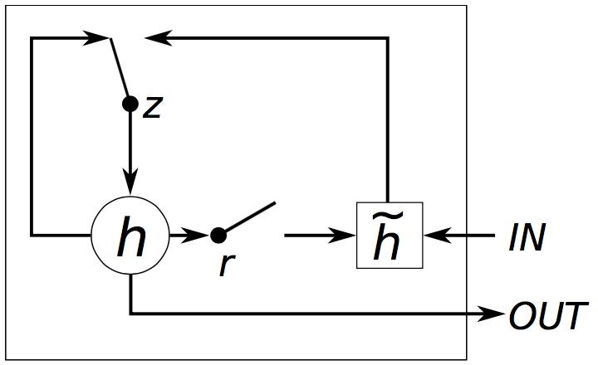
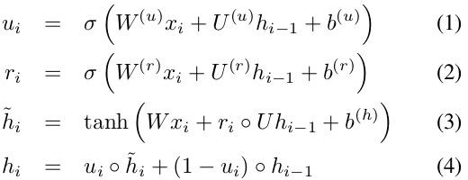
Gated Recurrent Unit (GRU)
Similar performance as LSTM with less computation.
Cho, Kyunghyun, Bart Van Merriënboer, Caglar Gulcehre, Dzmitry Bahdanau, Fethi Bougares, Holger Schwenk, and Yoshua Bengio. "Learning phrase representations using RNN encoder-decoder for statistical machine translation." arXiv preprint arXiv:1406.1078 (2014).

Slide 31
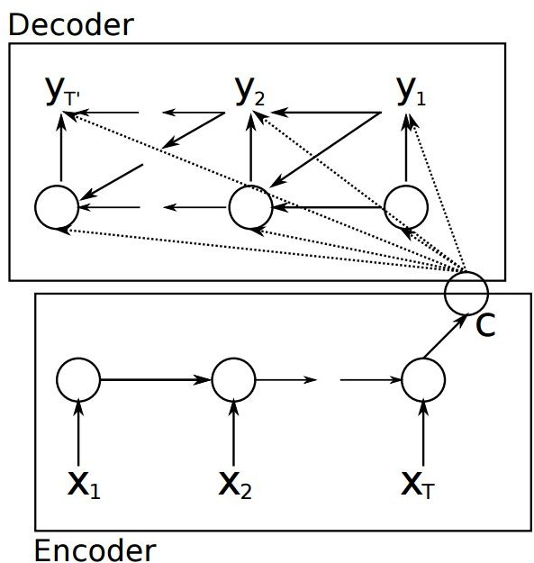
Applications: Machine Translation
Language OUT
Language IN
Cho, Kyunghyun, Bart Van Merriënboer, Caglar Gulcehre, Dzmitry Bahdanau, Fethi Bougares, Holger Schwenk, and Yoshua Bengio. "Learning phrase representations using RNN encoder-decoder for statistical machine translation." arXiv preprint arXiv:1406.1078 (2014).

Slide 32
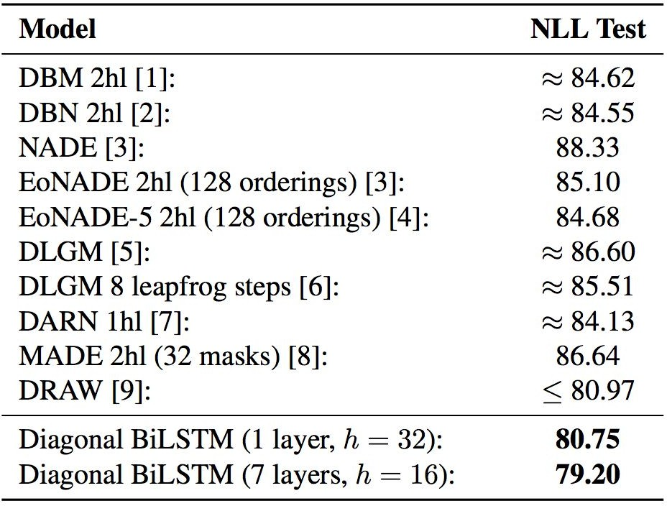
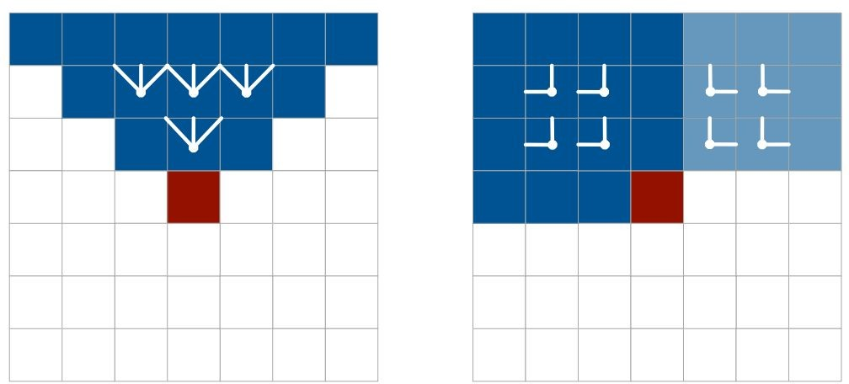
Applications: Image Classification
Diagonal BiLSTM
Classification MNIST
RowLSTM
van den Oord, Aaron, Nal Kalchbrenner, and Koray Kavukcuoglu. "Pixel Recurrent Neural Networks." arXiv preprint arXiv:1601.06759 (2016).
33

Slide 33
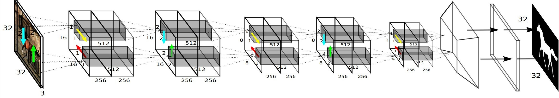
Applications: Segmentation
Francesco Visin, Marco Ciccone, Adriana Romero, Kyle Kastner, Kyunghyun Cho, Yoshua Bengio, Matteo Matteucci, Aaron Courville, “ReSeg: A Recurrent Neural Network-Based Model for Semantic Segmentation”. DeepVision CVPRW 2016.
34

